Slide 1
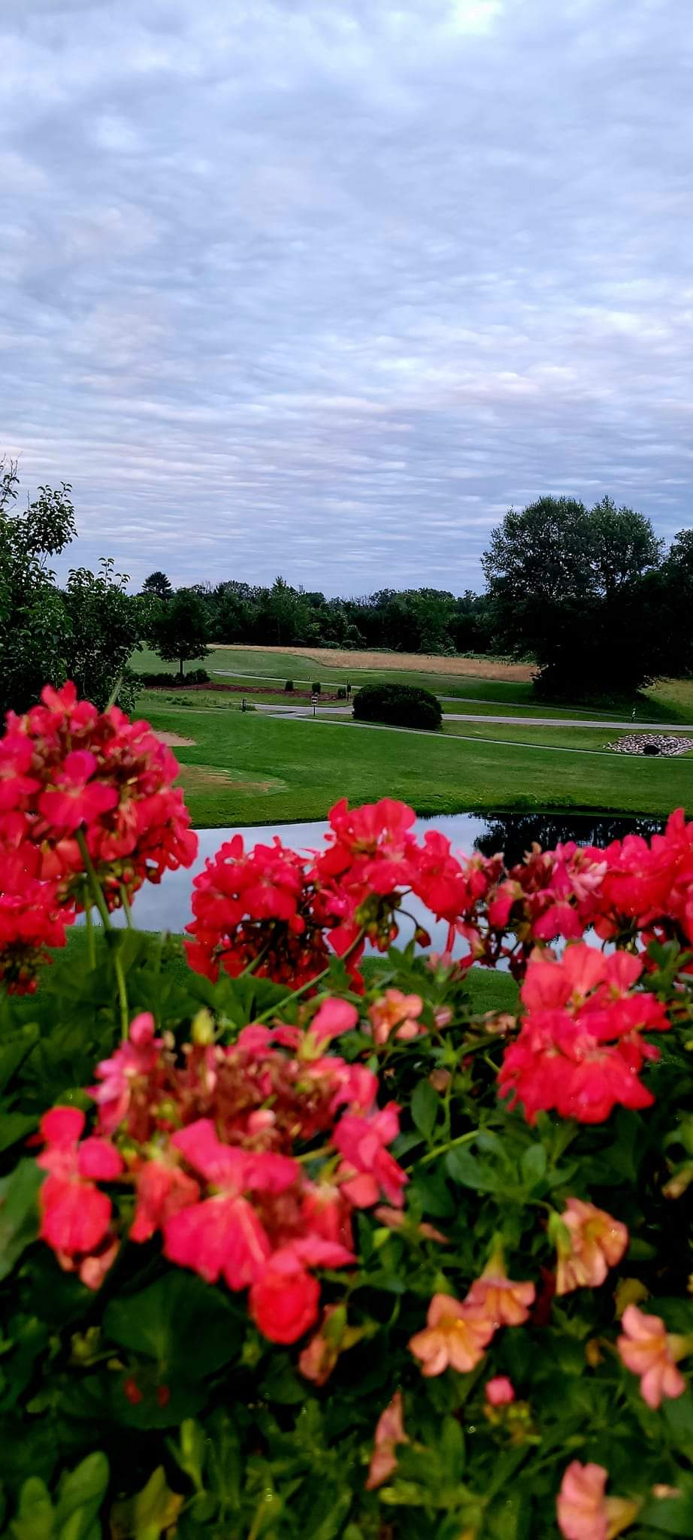
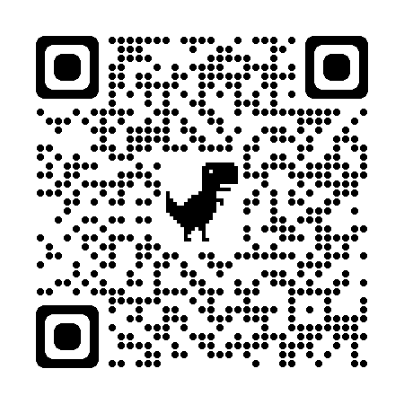
Sunset Condominiums
at
Northern Bay
1843A East 20th CT PVT
Arkdale, WI 54613
(608) 548.2824
scnbvrbo@outlook.com
Thank you for visiting Sunset Condominiums at Northern Bay! Our goal is to ensure you enjoy your stay in a family-friendly environment. If you have questions or need assistance, please contact the on-call SCNB Community Supervisor at 608.548.2824.
Notes:
To change this brochure, replace our sample content with your own. Or, if you'd rather start from a clean slate, press the New Slide button on the Home tab to insert a new page. Now enter your text and pictures in the empty placeholders. If you need more placeholders for titles, subtitles or body text, copy any of the existing placeholders, then drag the new one into place.
And did you notice we made fold marks for you? They are really light, but if you don’t like them showing on your brochure, select and delete them before you print.

Slide 2
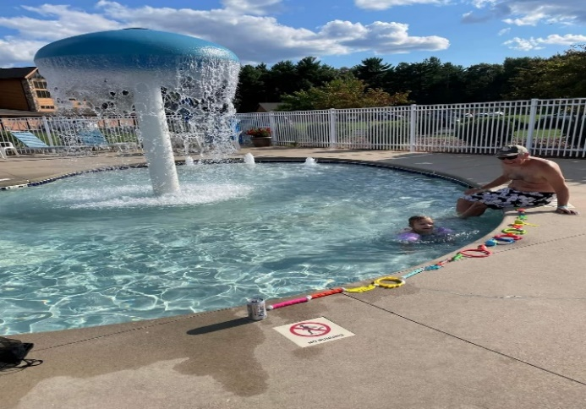
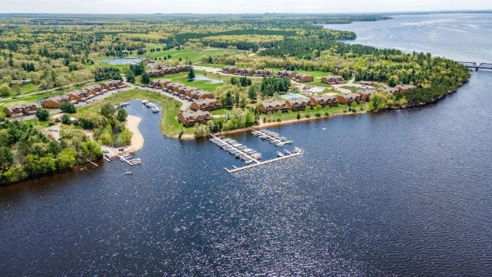
Rules and Regulations
Fine Protocol
Vehicles/Traffic
Sunset Condos Declaration of Condominiums, Article VIII, Section 8.07 Lease of Units: requires all guests, renters, & tenants to abide by Sunset Condominiums Declaration of Condominiums, Bylaws, & Rules and Regulations, which can be found on the Sunset Condos website @ https://sscanb.com
NO FIREWORKS
ALL FIREWORKS are prohibited. Violators will receive a $250.00 fine & the Adams Co. Sheriffs Dept. will be contacted. Sunset Condo reserves the right to evict Renters
Grills-must be 10’ away from any structure. Gas/Charcoal grills may be used on black top (10’ away from any structure) No grills allowed on patios/ 2nd/3rd floor decks. Grill violations will result in a $250.00 fine
Noise Restrictions/Quiet Hour is 11PM. Inappropriate or Disruptive behavior will not be tolerated
Safety Violations-open flames, fireworks, grill < 10’ from a structure= $250 fine. NO WARNINGS
Rules Violations
1st violation = warning
2nd violation=$50 fine
3rd violation=$100 fine
4th violation or a safety issue= $250 fine & Renters will be evicted
10 MPH Speed Limit
Follow one-way traffic flow
Only Park in designated areas
DO NOT PARK in front of another Owner’s Garage Unit
Improperly parked vehicles will be towed at Owner’s expense
Golf Carts/ATV/UTV’s-must have drivers license & ATV/UTV safety permit
Pool Hours-Seasonally 9:30am-9:30pm
Fitness Center- 5am-10pm
Volleyball-open seasonally
Tennis/Pickleball Courts-open seasonally
Utilize the QR code on the back page to visit the SCNB website-Guest/Renters page for more information about overflow vehicle & trailer parking, golf cart/ATV rules and regulations, as well as property-adjacent things to do during your stay!
Resort Amenities
Pool/Beach
PETS
All pets MUST be on a leash
Please pick up after your pet
Pets shall not be permitted to cause a nuisance or unreasonable disturbance
No Pets permitted in the pool-area, on the beach, or in the harbor-area
Wristbands MUST be worn in pool area
No GLASS bottles/containers permitted on pool deck
NO PETS in pool-area
NO Pets allowed on beach
Fires are NOT permitted at the beach
Notes:
To change this brochure, replace our sample content with your own. Or, if you'd rather start from a clean slate, press the New Slide button on the Home tab to insert a new page. Now enter your text and pictures in the empty placeholders. If you need more placeholders for titles, subtitles or body text, copy any of the existing placeholders, then drag the new one into place.
And did you notice we made fold marks for you? They are really light, but if you don’t like them showing on your brochure, select and delete them before you print.

